Slide 1
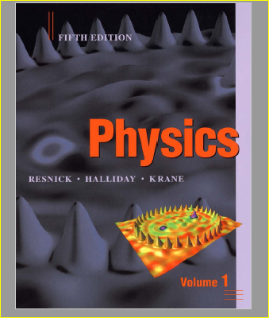
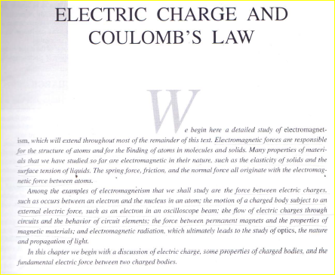
CH#25 = Electrostatics Electric Charge and Coulomb’s Law

Slide 2
Electromagnetism
Electricity and Magnetism ( Electromagnetism)
EM forces are responsible for the structure of atoms in molecules and solids.
Many properties of materials like elasticity of solids, and the surface tension of liquids, the spring force, friction, and normal force all originate with the electromagnetic force between them.
The bindings between electrons and nucleus in an atom etc
The Maxwell's equations are a set of four basic equations explain all basic electromagnetic effects.

Slide 3

Four Maxwell’s Equations
(i) ∮E.ds= $\frac{q}{{\text{ε}}_{0}}$
(ii) ∮B.ds=0
(iii) ∮E.dl=$\frac{d}{dt}$​ ∮B.ds
(iv) ∮B.ds= $μ_{0}{\text{ε}}_{0}$ $\frac{d}{dt}$​ ​∮E.ds

Slide 4
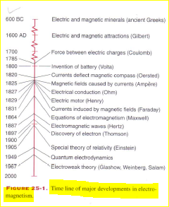
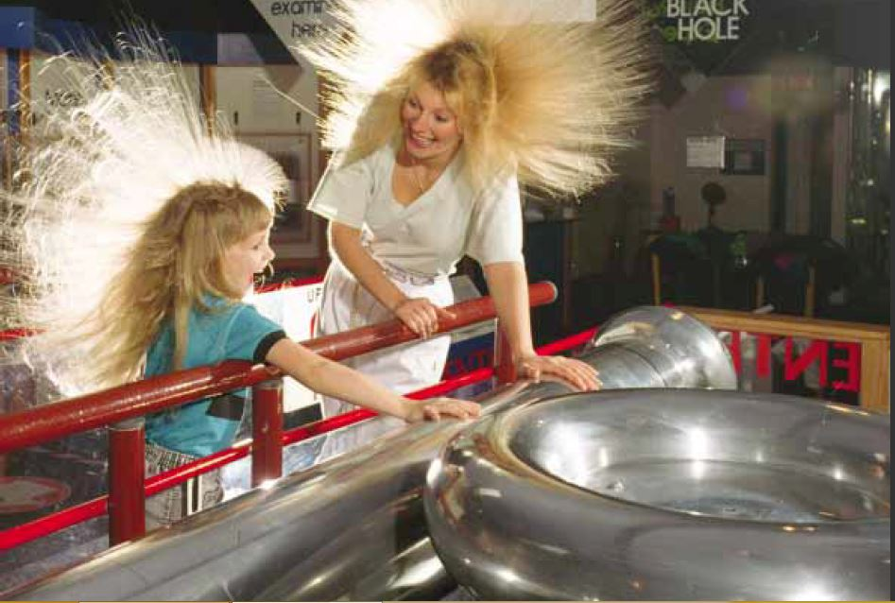
Time Line of Major Development in Electromagnetism

Slide 5
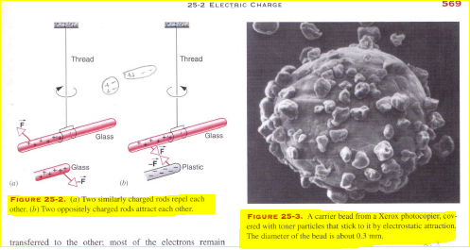
Electric Charge : It is a basic property of elementary particles of matter. A charge particle can attract or repel other particles with a force F. There are two types of electric charge; positive and negative, an object with an absence of net charge is referred to as neutral particle

Slide 6
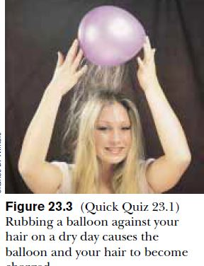
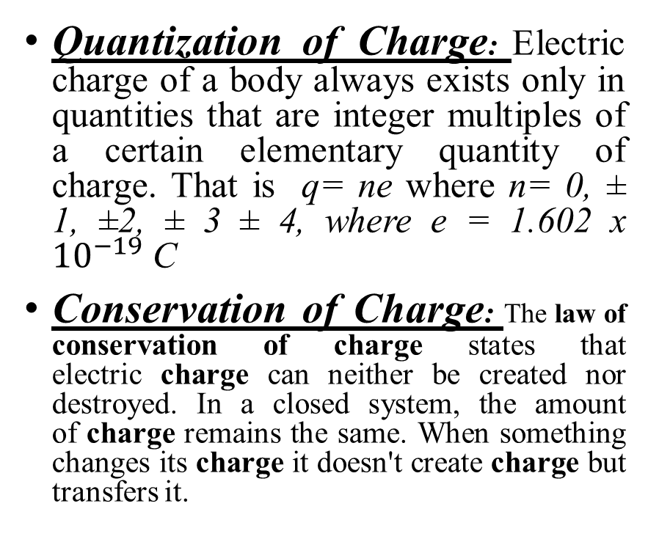
Important Properties of Charges
Quantization of Charge: Electric charge of a body always exists only in quantities that are integer multiples of a certain elementary quantity of charge. That is q= ne where n= 0, ± 1, ±2, ± 3 ± 4, where e = 1.602 x ${10}^{−19}$ C
Conservation of Charge: The law of conservation of charge states that electric charge can neither be created nor destroyed. In a closed system, the amount of charge remains the same. When something changes its charge it doesn't create charge but transfers it.

Slide 7
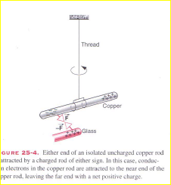
Conductors and Insulators
In some martials like metals, electrons can move relatively freely. We call these materials Conductors.
In other materials, electrons can hardly flow at all. Electrons deposited at one location will remain at that location. We call these materials as insulators

Slide 8
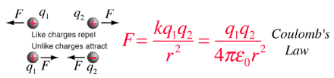
COLOMB’S LAW
Coulomb's law states that: The magnitude of the electrostatic force of attraction or repulsion between two point charges is directly proportional to the product of the magnitudes of charges and inversely proportional to the square of the distance between them. The force is along the straight line joining them.

Slide 9
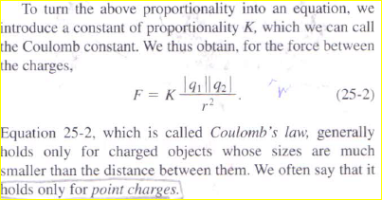
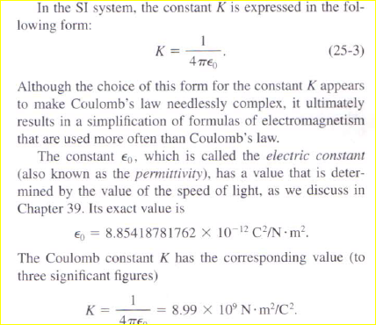

Slide 10
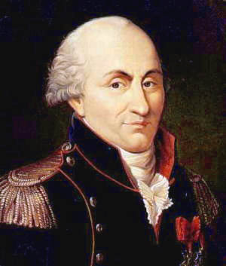
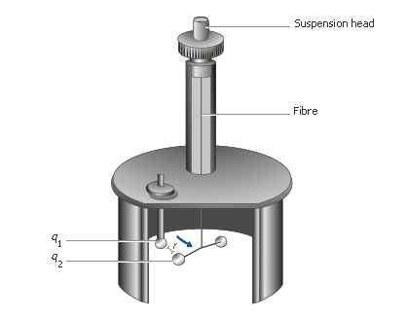
Coulombs Torsion Balance

Slide 11
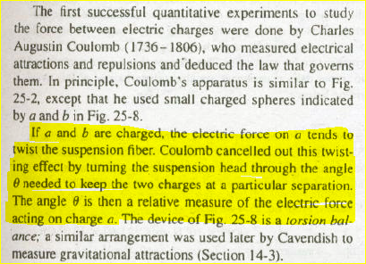

Slide 12
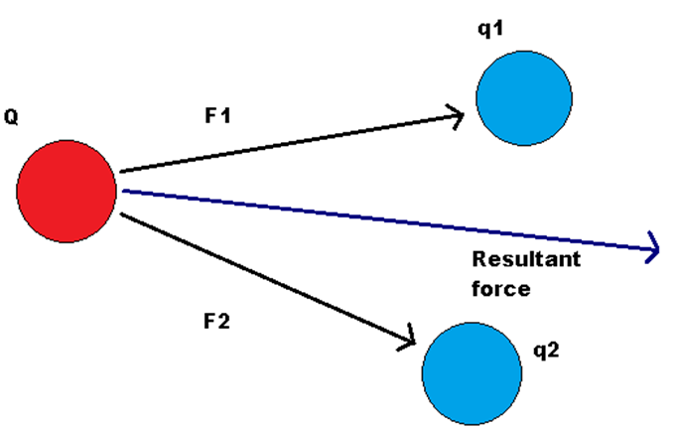
Coulomb’s Law and the principle of superposition.
The principle of superposition states that if a system contains a number of interacting charges, then the net force on any one charge due to the other charges is the vector sum of all the forces exerted on it by all the other charges. The individual forces are unaffected due to the presence of other charges.
Explanation: The principle of superposition gives a method to find force on a charge, when a group of charges are interacting.

Slide 13
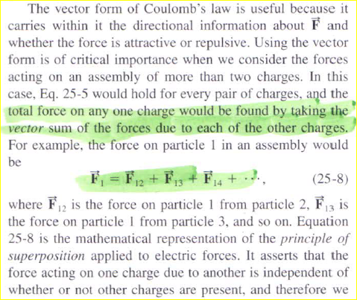
Coulomb’s Law and the principle of superposition.

Slide 14
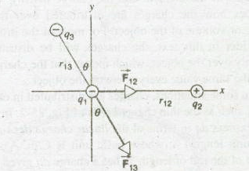

Slide 15
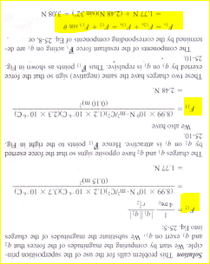

Slide 16
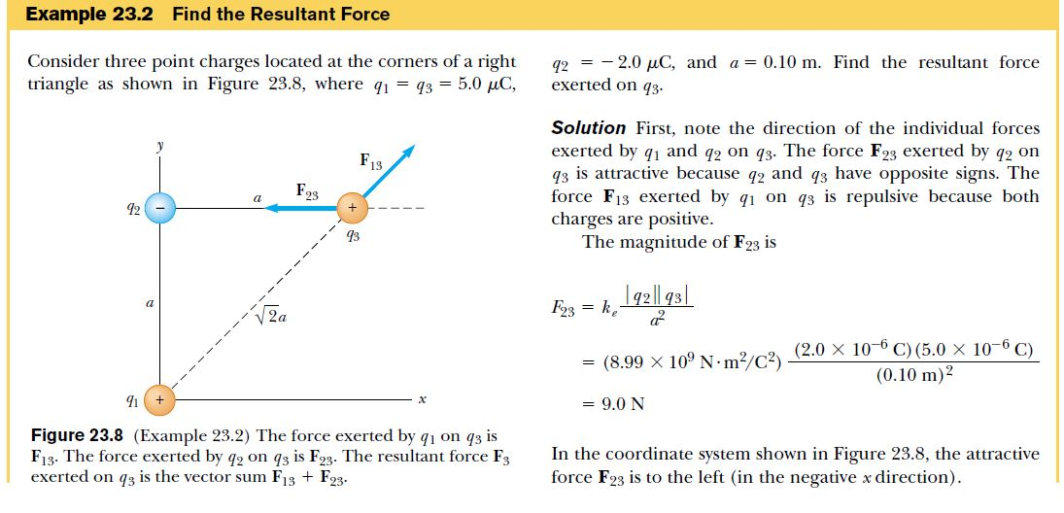

Slide 17
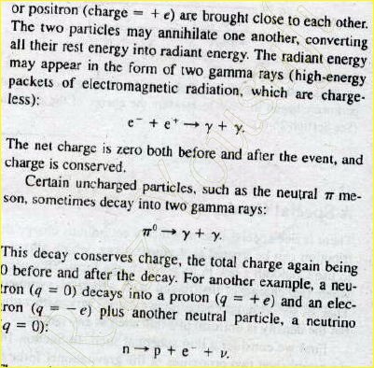
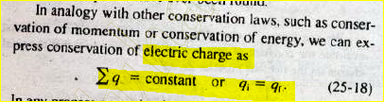
Conservation of Charge: In any Physical proces the total charge remains conserved. Charge transfers from one surface to another, but total charge remained constant.

Slide 18
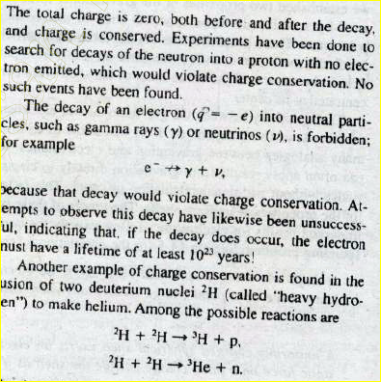
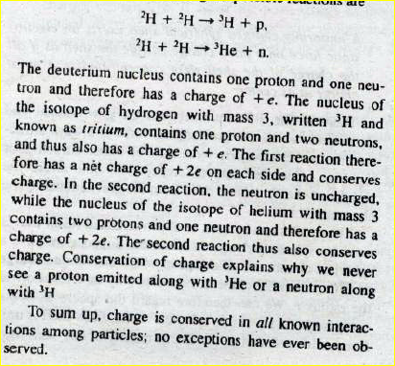

Slide 19
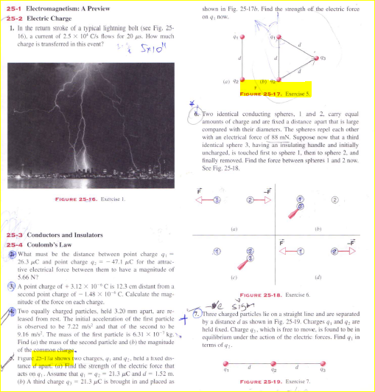
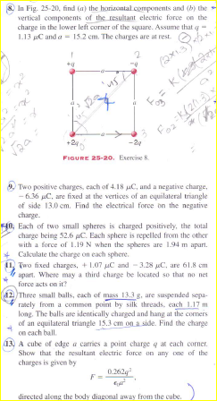

Slide 20
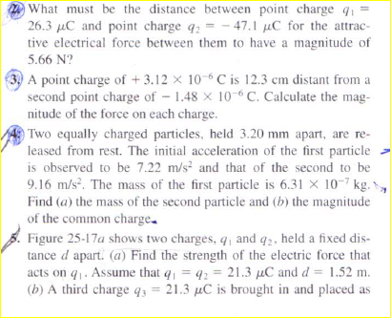
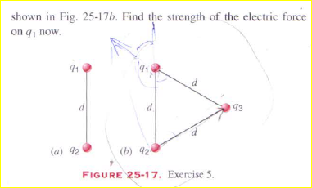

Slide 22
Home Task of the Week.
Section 25.4
Q # 2, 3, 4, 5 ,7 , 8, 9 , 10, 11, 12, 13.
Revision of all solved Problems of the relevant topics of the chapter.

